Slide 1

ATHENS UNIVERSITY OF ECONOMICS & BUSINESS
MSc in Data Science
Statistics for Big Data
Final Project – Supervised PCA

Slide 2

Supervised PCA – Survival Analysis Introduction
Classification of breast cancer patients into different risk classes is very important in clinical applications. The cause of breast cancer is not common to every patient. It is estimated to be highly correlated with a combination of gene expression data.
From the biological aspect, only a small portion of genes contributes to the patients’ survival. A substantial challenge is to select the most significant of them, as these may depend on each other. Because of the large number of genes, it is easy to find genes that are significant for a specific sample of patients, but not significant for others, leading to misleading rules.
ATHENS UNIVERSITY OF ECONOMICS & BUSINESS - MSc in Data Science - Statistics for Big Data – July 2018

Slide 3
Supervised PCA – Survival Analysis Analyzing our Data
In this project, we are dealing with data referring to 78 patients and part of their gene profile, around 25.000 genes.
The outcome was survival time measured in months and ranging from 3 months to 13,4 years.
Due to the fact that the number of genes is significantly larger than the number of observations data pre-processing for dimensionality reduction is essential in our analysis.
ATHENS UNIVERSITY OF ECONOMICS & BUSINESS - MSc in Data Science - Statistics for Big Data – July 2018

Slide 4
Supervised PCA – Survival Analysis Dimensionality Reduction – Missing Values
For all our patients missing information was observed regarding a certain amount of genes.
The average amount of missing data per patient was around 300 genes.
Two exceptional cases with 3.000 and 10.000 missing values each.
To proceed with our analysis the patient with the 10.000 missing observations was removed from the dataset and the rest were filled using the imputation process.
Throughout the dataset 293 genes were observed that had no information across the patients, those genes were removed from the dataset.
ATHENS UNIVERSITY OF ECONOMICS & BUSINESS - MSc in Data Science - Statistics for Big Data – July 2018

Slide 5
Supervised PCA – Survival Analysis Dimensionality Reduction – Correlation Filtering
Spearman correlation test was used to keep the genes that are the most correlated with the months of survival.
Non-parametric type of test for correlation between a categorical and continuous variables which is more lenient regarding the model’s assumptions.
Two different approaches were tested for the pre-filtering.
Step 1 Correlation: run a correlation test one time and keep only the coefficients that were above a 5% significance level
Step 2 Correlation: split the data randomly in two halves and check significance in every sample (i.e. for each gene test twice) at significance level of 5% and choose the genes that are significant in both tests.
* Note that from the 897 genes remaining after the Step 2 Correlation the 821 are in the larger set of 3456.
 | Step 1 Correlation | Step 2 Correlation
Threshold | 0.05 | 0.05
Number of Remaining Genes | 3456 | 897
ATHENS UNIVERSITY OF ECONOMICS & BUSINESS - MSc in Data Science - Statistics for Big Data – July 2018

Slide 6
Supervised PCA – Survival Analysis SPCA Analysis
In order to identify the genes that are correlated the most with the time of survival, we used the Supervised Principal Component Analysis.
Supervised principal components is a generalization of principal components regression.
Compute (univariate) regression coefficients for each gene.
Form a reduced data matrix consisting of only those genes whose univariate coefficient exceeds a threshold theta in absolute value (theta is estimated by cross-validation)
Compute the first (or first few) principal components of the reduced data matrix
Keep the genes most correlated to the principal components.
ATHENS UNIVERSITY OF ECONOMICS & BUSINESS - MSc in Data Science - Statistics for Big Data – July 2018

Slide 7
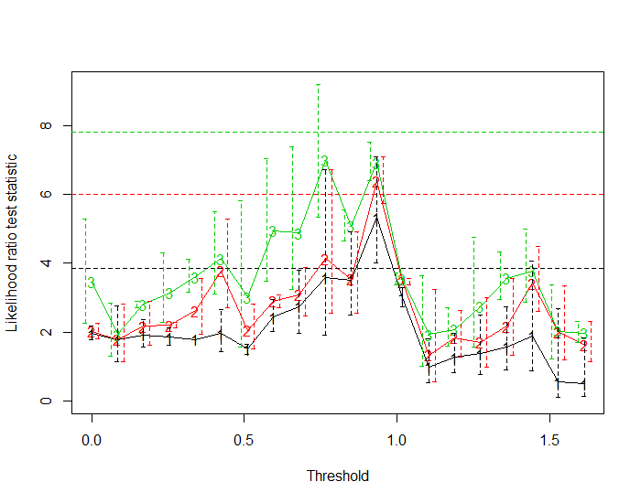
Supervised PCA – Survival Analysis SPCA Analysis - Description of the model
In order to obtain principal components related to survival we run univariate survival regression of each gene with the time (in months) that the patient survived. Then we train our model and derive the log-likelihood ratio test statistic to get the first three principal components.
The Likelihood-Ratio helps us choose the “best” model between two or more nested models.
The maximum Likelihood Ratio of the 1rst Principal component holds for threshold equal to 0.92. For this threshold we reduce the selected genes to 258 from 3546.
ATHENS UNIVERSITY OF ECONOMICS & BUSINESS - MSc in Data Science - Statistics for Big Data – July 2018

Slide 8
Supervised PCA – Survival Analysis SPCA Analysis - Description of the model
We use the 258 genes to calculate the eigen-genes that we finally regress on the survival time.
By this process, we derive the statistical significant principal component. As we observe from the table below, the 1st principal component is by far the most statistically significant component. Thus, in the next steps we use this component to reduce the number of genes in our predictor.
 | coef | exp.coef. | se.coef. | z | Pr(>|z|)
score.1 | 25.569 | 1.27E+11 | 3.566 | 7.169 | 7.53E-13
score.2 | 4.054 | 57.631 | 1.625 | 2.493 | 0.012
score.3 | 1.891 | 6.626 | 1.925 | 0.982 | 0.326
ATHENS UNIVERSITY OF ECONOMICS & BUSINESS - MSc in Data Science - Statistics for Big Data – July 2018

Slide 9
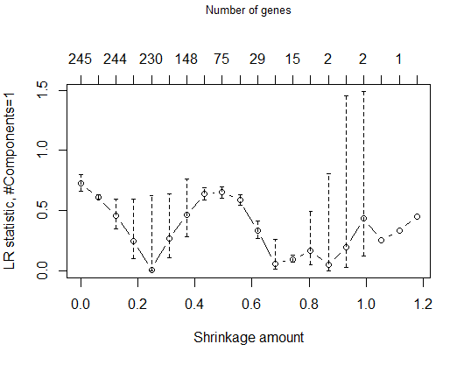
Supervised PCA – Survival Analysis SPCA Analysis - Description of the model
Finally, we look for a predictor of survival a small number of genes (rather than all 258 genes). We do this by computing an importance score for each which is the correlation with the supervised PC predictor.
Then we soft threshold the importance scores, and use the shrunken scores as gene weights to from a reduced predictor. Cross-validation gives us an estimate of the best amount to shrink and an idea of how well the shrunken predictor works.
The x-lower axis shows the different shrinkage amounts and the x-upper axis the number of genes. The y axis shows the corresponding Likelihood-Ratio of the model at which gene's absolute important scores are larger than the shrinkage amount.
The maximum Likelihood Ratio holds for shrinkage amount equal to ~0.5 that corresponds to 75 genes.
ATHENS UNIVERSITY OF ECONOMICS & BUSINESS - MSc in Data Science - Statistics for Big Data – July 2018

Slide 10
Supervised PCA – Survival Analysis Conclusion
Throughout the analysis we observed a large variability in our final gene selection each time we were tweaking with the thresholds of the SPCA or by changing the pre-processing dataset.
Generally, SPCA is a compelling tool to use due to its simplicity but we did not manage to get a stable solution when using it.
This may stem from the fact that the number of observations is very small (only 75 patients) comparing to the features (25.000 genes).
ATHENS UNIVERSITY OF ECONOMICS & BUSINESS - MSc in Data Science - Statistics for Big Data – July 2018

